Slide 1
Cloud computing and virtualization
Author: Verbytskyi Artem IPS-21

Slide 2
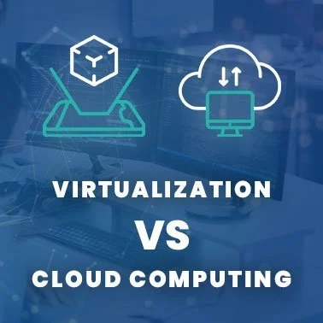
Are virtualization and cloud computing the same?

Slide 3
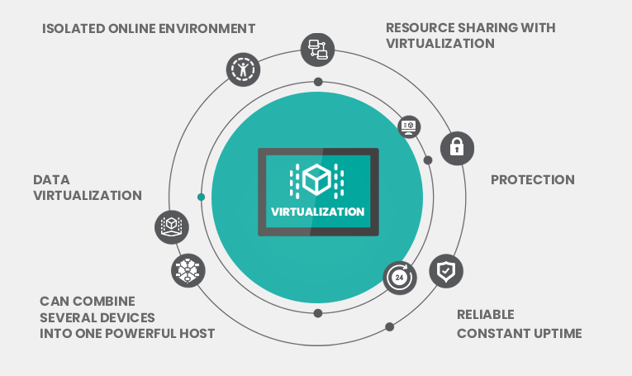
What is virtualization?

Slide 4
Characteristics of virtualization
Resource Sharing
Isolation
Availability
Aggregation
Reliability

Slide 5
Use cases and examples of virtualization
Server virtualization
Data Virtualization
Software virtualization
Desktop virtualization
Storage virtualization

Slide 6
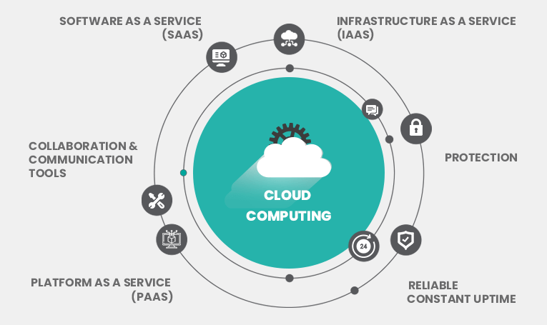
What is cloud computing?

Slide 7
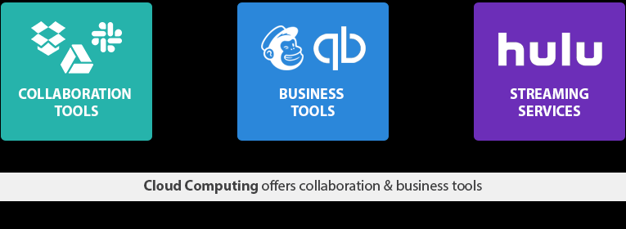
Categories of the cloud computing services
Software as a Service (SaaS)
Infrastructure as a Service (IaaS)
Platform as a Service (PaaS)

Slide 8
Cloud computing characteristics
Dedicated internet access
Measured service
Shared resource pooling
On-demand self-serve access
Rapid elasticity

Slide 9
Use cases and example of cloud computing
Streaming services
Data analytics and business intelligence
Business tools
Collaboration & communication tools

Slide 10
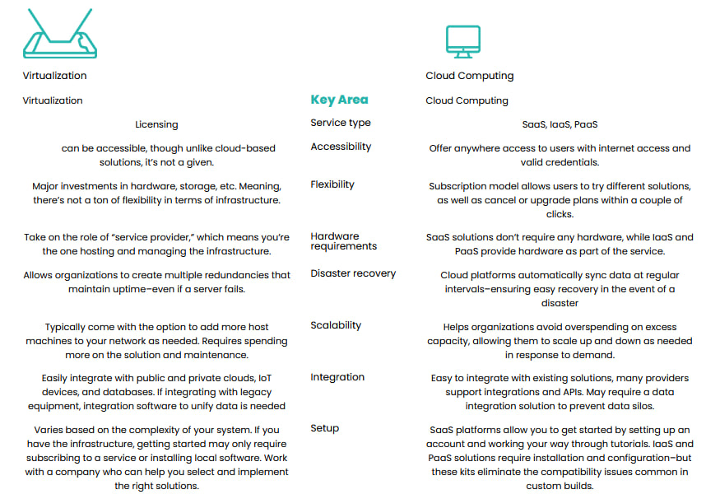
Virtualization vs. cloud computing

Slide 11
Thanks for attention!

